Slide 1
Lesson objective
PBiS focus:
Respect – listening
Achieve – attempt all tasks
Need whiteboards and calculators.
Title: Topic review 2
Aim – be able to:
Solve equations and missing angles
Complete a table of values with missing values
Plan:
Angles and equations
Table of values
Test Wednesday!

Slide 2
Ex2
The graph shows a cyclist’s journey, from home, to a café and back.
40
Solution
How long was the cyclist’s journey in total?
Explain what the horizontal line indicates.
What was the cyclists speed in miles per hour when he was heading home?
30
Distance from home (miles)
20
10
0
0
1
2
3
4
5
6
7
Time (hours)

Slide 3







What is the angle?
Whiteboards
$$65°$$
B
A
$$50°$$
50$°$
$$42°$$
D
$$70°$$
C
$$E$$
$$90°$$

Slide 4
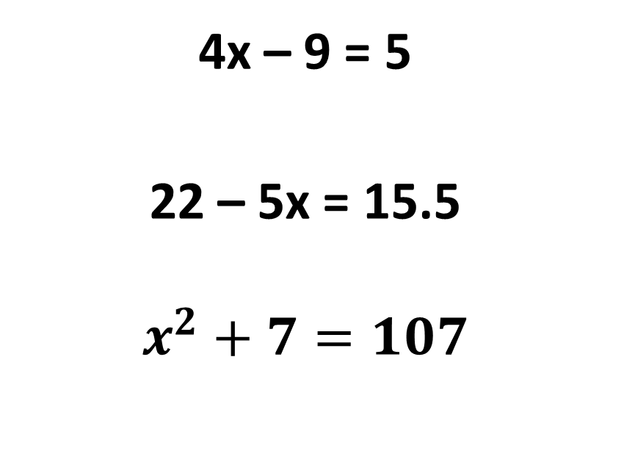
Whiteboards
You do
You do
2f – 9 = 15
3f + 11 = 26
5g – 7 = 15
4x – 9 = 5
22 – 5x = 15.5
$$x^{2}+7=107$$

Slide 5
What are the missing numbers?
x | 0 | 1 | 2 | 3 | 4
y | a | 5 | 7 | 9 | b
x | 2 | 3 | 4 | 5 | 12
y | 4 | 6 | 8 | 10 | c
x | 0 | 1 | 2 | 3 | 20
y | 2 | 5 | 8 | 11 | d

Slide 6
Difficult… think about a pattern
The coordinates (1, 3) and (4, 15) belong to a set of values that will make a straight line when plotted. Complete the table below for this set of values
x | -2 | -1 | 0 | 1 | 2 | 3 | 4
y

Slide 7
Difficult… think about a pattern – you try
The coordinates (2, 6) and (4, 16) belong to a set of values that will make a straight line when plotted. Complete the table below for this set of values
x | -2 | -1 | 0 | 1 | 2 | 3 | 4
y

Slide 8
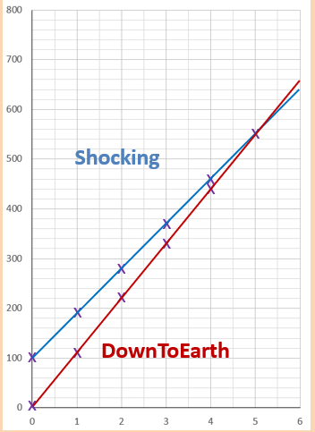
Match the table of values to the linear functions drawn (Shocking or DownToEarth).
Making a rule for both (can use table of values)
What is significant about hour 5 for these companies?
x | 0 | 1 | 2 | 3
y | 0 | 110 | 220 | 330
This is: ____________
x | 0 | 1 | 2 | 3
y | 100 | 190 | 280 | 370
This is: ____________

Slide 9
Individual practice
Complete the revision sheet today.

